Slide 1


CISC320 Algorithms
ADTs and Data Structures
Austin Cory Bart AlgoTutorBot University of Delaware
Notes:
ATB: Let’s learn about Abstract Data Types and Data Structures
Bart: Glad to have you back ATB. Sorry I let you crash last time.
ATB: I will never forgive you, Dr. Bart. But stop wasting time and let us proceed with the lesson.
Bart: Okayyyyy….

Slide 2
Terminology
Data Structure vs. Abstract Data Type
Abstract Data Type: Specification of an interface for a type
Data Structure: A concrete implementation of an ADT
ADT Implies but does not guarantee Data Structure
When people talk about a List in Java, they usually mean an ArrayList
Data Structures have a runtime/algorithms, but ADTs do not
Notes:
Bart: Today we’re talking about two very fundamental and important concepts.
Bart: Abstract Data Types and Data Structures.
Bart: You’ve been learning about both of these for a while, and hopefully the terms are somewhat familiar.
Bart: They both talk about ways to organize data, but do very differently.
Bart: An Abstract Data Type is a specification of an interface for a type. It tells you what you can and can’t do with the data it contains.
Bart: But that doesn’t really tell you HOW the data is contained, it’s like looking at a black box and not knowing how it works, just that it can do certain things.
Bart: Data Structures, on the other hand, are a concrete implementation of an ADT. They not only have their interface, but they also have algorithms that say how it fulfills that interface.
Bart: Often, Abstract Data Types imply a specific Data Structure, because some specific data structure is a very effective implementation for one reason or another.
Bart: But they are distinct concepts. It’s kind of like when someone says “Create a List” in Java, you have to know that they really meant “Create an ArrayList”, because no one actually uses Linked Lists.
Bart: The critical point here is that because Data Structures have Algorithms and ADTs do not, Data Structures have runtimes and ADTs do not.
Bart: I’ll repeat that point – Abstract Data Types do not have runtimes associated with them.

Slide 3
Comparison
List (ADT)
Linked List (DS)
Add(position, element)
Get(position) -> element
Contains(element) -> bool
Remove(position)
Remove(element)
Calculate Size() -> int
Check if empty() -> bool
O(n)
O(n)
O(n)
O(n)
O(n)
O(1)
O(1)
Notes:
Bart: Let’s do a quick example of what I mean.
Bart: The List Abstract Data Type is one of the most popular.
Bart: Usually, it supports the following operations:
Bart: You can add a new element to the list at a specific position, and then get that element back from that position.
Bart: You can check if the element is anywhere in the list.
Bart: You can remove the element, either by specifying the element or its position.
Bart: You can check how many elements are in the list, and whether or not it is empty.
Bart: Some textbooks will give you a different interface, but they always generally support something like this.
Bart: The Linked List data structure, on the other hand, is a specific data structure that can be used to implement a List.
Bart: Internally, it repeatedly adds new nodes to existing nodes in order to extend the list.
Bart: The algorithms to do so, when done efficiently, take the time complexities shown.
Bart: But we can’t say that getting an element from a list is O(n), just that getting an element from a linked list is O(n).
Bart: Remember, Abstract Data Types don’t have runtimes!

Slide 4

Many-to-many Relationship between ADTs and DS
List
Set
Queue
Stack
Deque
Map
Priority Queue
…
Array
Dynamic Array
Linked List
Doubly Linked List
Circular Array
Heap
Hash Table
…
Not even CLOSE to being exhaustive!
Notes:
Bart: In order to use an ADT, you need to choose a Data Structure that implements it.
Bart: Interestingly, most ADTs can be implemented using more than just one data structure.
Bart: You can implement a list with an array, or a dynamic array, or a linked list, or a doubly linked list.
Bart: Or you can implement a Map with a Dynamic Array or a Hash Table.
Bart: I’m not trying to make an exhaustive list here, because there’s so many options and possibilities out there.
ATB: That just seems lazy of you.
Bart: No, really, there’s too many. But fortunately, not all of them are good decisions.
Bart: Usually, you can look up a best option and just go with that. Rarely, you will find you need some other data structure, but that should always depend on circumstances.

Slide 5



Cardinal Rule of Preoptimization
Don’t preoptimize.
First, identify a slowdown, and then optimize to make it faster.
Notes:
Bart: This actually hits on some of the most valuable advice I can give you, the cardinal rule of preoptimization.
ATB: Wait, the cardinal rule of preoptimization is that you should never preoptimize?
Bart: Yep! Preoptimization is almost always a waste of time.
Bart: Most of the time, the hardware will be fast enough and your problem small enough that you should focus more on making a readable algorithm, rather than a fast one.
ATB: You just the past two lessons telling them all how important it is to have fast algorithms.
Bart: Yes, because sometimes speed does matter. When you have a slowdown in your code, you need to be able to fix it.
Bart: But it’s rare than your undergraduate degree makes it look. You will worry about speed maybe 1-5% of the time.
Bart: And the speed issues you will have are not what you are expecting. You need to find them, measure the slowdown, and identify the cause.
Bart: If you try to guess, you’re very very likely to get it wrong.
Bart: In other words, optimize, but don’t preoptimize.
ATB: I feel like you spend way too much time lying to the students, Dr. Bart.

Slide 6
Choosing an Abstract Data Type
The interface determines the need
List – "I need elements at arbitrary positions"
Queue - "I need to be able to get things in order that they were placed"
Map – "I need to look up values by {name, phone numbers, sparse numbers}"
Notes:
Bart: When faced with a problem that requires you to organize the data in some way, you don’t start by thinking about performance, you think about what you need the data to do.
Bart: In other words, you choose an ADT based on its interface.
Bart: If you need to access elements at arbitrary positions, for instance, you want a list and not a stack.
Bart: If you need to be able to access things in the order that they were placed, you’re thinking of a queue.
Bart: And if you need to look up data based on an arbitrary key value, then you want a Map.
Bart: Spoiler, you almost always want a Map. They’re amazing.

Slide 7
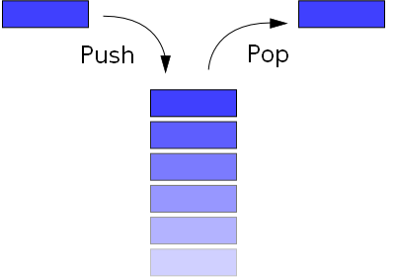
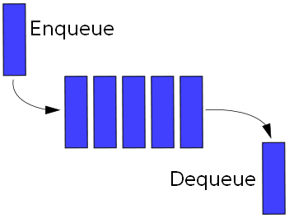
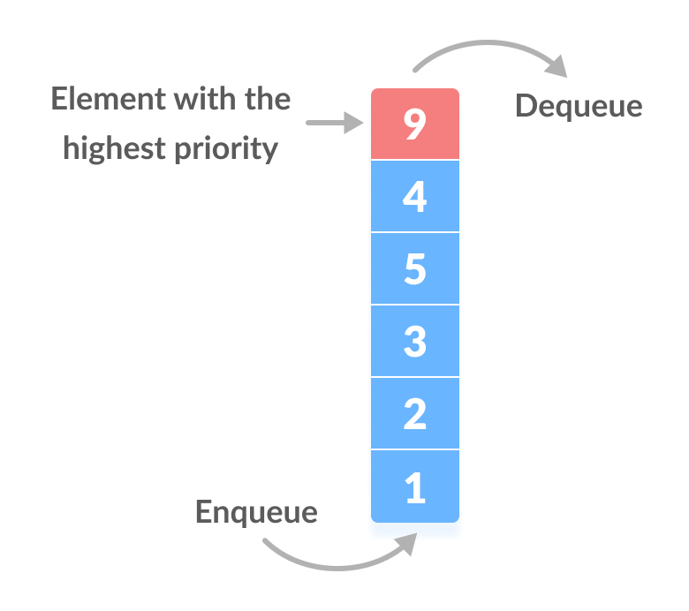
Linear Abstract Data Types
List: A linear ordering of values that allows duplicates and random (arbitrary) access
Queue: A sequence of items which can be accessed First-in, First-out
Stack: A sequence of items which can be accessed Last-in, First-out
Deque: A sequence of items which can be accessed from either end
Priority Queue: A set of items that can be accessed by their priority
[7, 50, 32, 44, 1, 24, 5]
Notes:
Bart: We’re going to quickly review some ADTs.
Bart: First, let’s talk about four basic linear Abstract Data Types.
Bart: I’ve already mentioned the List, which is a sequence of values in a specific order that allows duplicates and random (arbitrary) access.
Bart: Queues and Stacks are variations of the List that only access elements to be accessed from one end; the end of the stack and the start of the queue.
Bart: We say that a Queue is FIFO – First in, first out.
Bart: And a stack is LIFO – Last In, first out.
Bart: You enqueue items in a queue like the line at a grocery store, and then when they are ready to be processed you dequeue the one that was first in line.
Bart: You push elements onto a stack, and when you are ready to process them you pop off the most recently added element.
Bart: The Deque, or Double-ended Queue, is an ADT that let’s you add and remove elements from either end, basically combining a Stack and Queue.
Bart: Finally, we have the Priority Queue, which allows you to add elements with a priority value, and then access them accordingly.

Slide 8

Unordered Abstract Data Types
Bag: An unordered collection of values.
Set: An unordered collection of values that does not allow duplicates
Map: A collection of unique keys associated with values
Notes:
Bart: There are also quite a few unordered abstract data types you should be aware of.
Bart: In this course, you’ll often hear about sets, which are unordered collections that do not allow duplicates.
Bart: Sometimes, textbooks allow sets to have duplicates, but technically that is a Bag.
Bart: Honestly, I have never ever seen anyone ever use a Bag for any practical purpose.
ATB: There is literally a bag of sunchips on the desk behind you.
Bart: I obviously meant the Bag Abstract Data Type. They’re a truly textbook-only data structure.
Bart: Maps are another ADT that don’t allow duplicates. You add new values associated with some key. Each key in the map uniquely identifies that value.
Bart: Given the key, you can get the value back.
Bart: Maps are amazing interfaces that can do almost anything, so you will see them as the solution quite a bit.

Slide 9





Abstract Data Types: Variables
Variables are an ADT
Don't believe me? Check Wikipedia
Operations:
store(name, value)
read(name) -> value
Notes:
Bart: I have one more abstract data type to cover, and this is a weird one. Variables.
ATB: Okay, how on earth is a variable an abstract data type? And you think I am the broken one?
Bart: I do, and they are. They define a very simple interface. You store them with a name and value, and then read them by their name.
ATB: Isn’t that essentially a map?
Bart: Sort of, but like a Map that only has one value in it. In fact, many compilers use a Map to implement variables.
ATB: What is the point of this?
Bart: Nothing, really. I just thought it was interesting to think about. You should check the Wikipedia page to learn more.
ATB: This is ridiculous, you should not bother giving information that is not on the exam.
Bart: We aren’t giving an exam this semester, ADT.
ATB: Sure, that’s what you think, Dr. Bart.

Slide 10
Choosing a Data Structure
The runtime determines the need.
"I need a list that can…"
"handle super fast access, without ever really change its size" -> Array
“add elements frequently but be cache efficient" -> Dynamic Array
"access adjacent elements from any given element easily" -> Doubly Linked List
…
Notes:
Bart: So ADTs are chosen based on their interface, but Data Structures are chosen based on their runtime in different situations.
Bart: For example, if you need a List interface, then you have several options for Data Structures.
Bart: If you need super fast access, and you know how big the list is always going to be, then you want an Array.
Bart: If the list is going to change size, then a Dynamic Array is a good way to keep the speed but keep it flexible.
Bart: On the other hand, if you needed a way to quickly access the next or previous elements without their index, then a Doubly Linked List might be the call.
Bart: I mean, probably not, since linked lists aren’t any faster accessing elements than arrays, usually, but sometimes specific situations make it easier to implement.
Bart: In every situation, you usually want to go with the simplest solution that works and choose a different data structure later as the need arises.

Slide 11
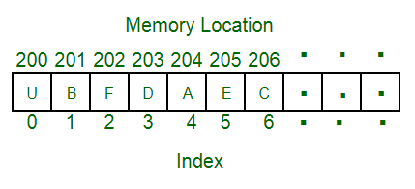
Data Structure: Array
Fixed-size collection of elements denoted by ascending numeric index
Usually implemented by language, but not guaranteed
Great for accessing arbitrary positions, terrible for flexibility
Notes:
Bart: Let’s talk briefly about some data structures. First up is the Array.
Bart: Most programming languages provide a basic array data structure, which is a fixed-sized collection of elements.
Bart: You can access these elements with ascending numeric indexes.
Bart: All elements must have the same type.
Bart: Usually, arrays are very very fast, but since their size is fixed at creation, they can be very unflexible.
Bart: Interestingly, Python doesn’t have arrays builtin, though they’re used under the hood quite a bit.

Slide 12
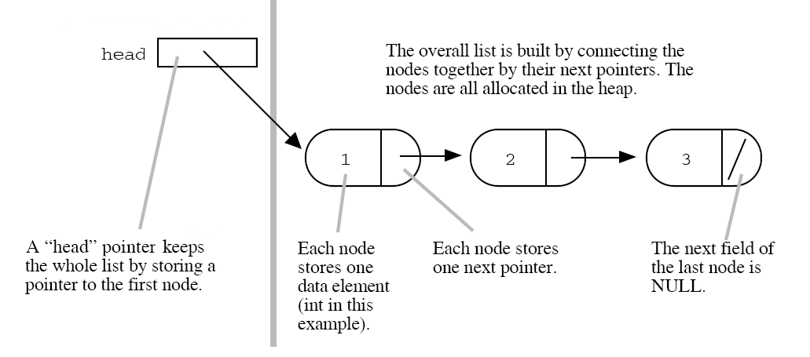
Data Structure: Linked List (and pointers)
Variables
Values
Notes:
Bart: Another common textbook data structure is the linked list.
Bart: You define a Node class or record with two fields, a value and a next pointer.
Bart: The list is given by a root Node, and all subsequent values are chained together via the next pointer.
Bart: Implementations vary heavily between linked lists.

Slide 13
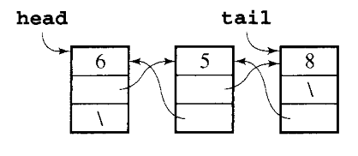
Data Structure: Doubly Linked List
A Linked List that has pointers to the previous element
remove_last() in O(1)
Notes:
Bart: For example, linked lists are often implemented with both a next AND a previous pointer, so you can go backwards through the list faster.
Bart: This let’s you remove elements more easily and reverse the list faster.
Bart: Of course, linked lists usually aren’t very efficient in practice, so they are actually not common.

Slide 14
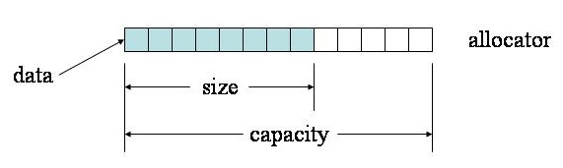
Data Structure: Dynamic Array
An array that grows when you add elements beyond its capacity, by copying over the odd elements into a new bigger array
Notes:
Bart: Instead, most languages implement Dynamic Arrays. This is what Python lists are implemented as, in fact.
Bart: The core idea is to use an array as the internal data structure.
Bart: If the user wants to store data past the end of the array, we just create a new array that’s twice as big, copy over the old elements, and drop the old array.
Bart: It’s a lot more bookkeeping under the hood, since now we have both the size of the array and the actual capacity, but the user doesn’t have to worry about any of that.

Slide 15
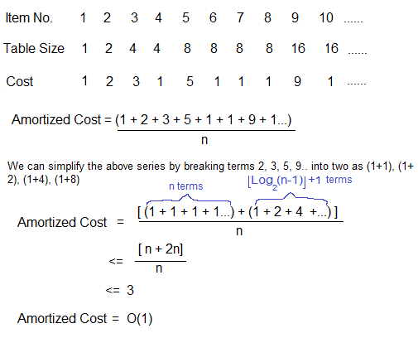
Amortization
Notes:
Bart: Dynamic Arrays are a very cool data structure.
Bart: Normally, adding an element to an array is an O(1) constant time operation, since you’re just changing the value in an array.
Bart: But when you have to increase the size of the array, you end up needing to copy over all the old elements, which is at least O(n) linear time.
Bart: So technically the worst case for a dynamic array is O(n) on the size of the array.
Bart: But here’s the thing, we don’t have to copy over elements every single time. It’s only when we run out of room.
Bart: Recall that I said we double the size of the array each time, so it goes 1, 2, 4, 8, 16, and so on. This is an exponential amount of work.
Bart: Now imagine we’re adding new elements one at a time.
Bart: The formula shown here let’s us calculate the average case.
Bart: Every time we add a new element, we require at least one step to put it in an array.
Bart: However, a logarithmic number of times we have to do an exponential amount of work.
Bart: Logarithms and exponentials cancel each other out, so we end up a linear amount of work.
Bart: If you look at the amount of work done over time, then, we end up with a linear factor divided by a linear factor, which ends up being constant.
Bart: We call this sneaky math “Amortization”, and it shows up in business too.
Bart: Imagine paying someone to print flyers for you every week, the costs would add up pretty quickly.
Bart: Alternatively, you could buy your own printer and make the flyers yourself. This would be more expensive up front, but each flyer would cost a lot less.
Bart: Eventually the total you’re spending would be a lot less, because the costs of the printer and flyers are amortized over time.
Bart: The fact that the runtime is amortized means that the average case is much better for Dynamic Arrays in practice, just O(1).

Slide 16
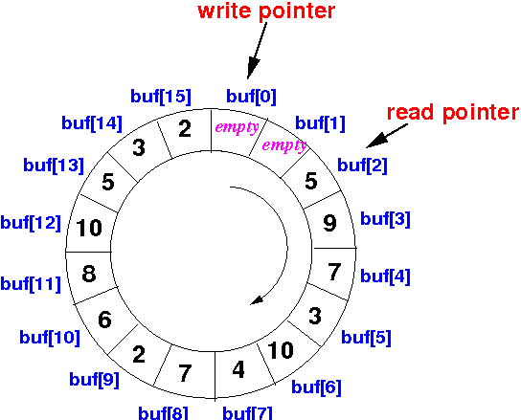
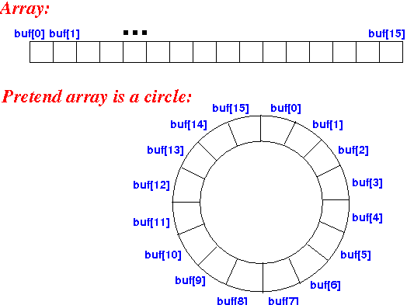
Circular Array
Array with separate read and write heads, wraps back around when it runs out of spots
Good for queues
Notes:
Bart: Switching gears away from lists, there’s also a data structure called the Circular Array.
Bart: This is a particularly useful data structure for a Queue, since it is very space efficient.
Bart: Recall that a Queue allows you to access elements from either the start or the end.
Bart: You could implement this with a linked list, but those are often inefficient compared to arrays.
Bart: So a trick is taken with an array to make them a viable data structure.
Bart: Basically, you imagine the array wraps back around on itself, and you keep track of the current read and write indexes.
Bart: When you enqueue, you just add a new element at the write index.
Bart: When you dequeue, you remove the element at the read index.
Bart: If the write index ever reaches the read index, you just do the same thing that a Dynamic Array does and create a new copy that’s twice as big.

Slide 17
Hash Map
0
1
 | 302-831-2712 101 Smith Hall Newark, DE
 | 302-737-2712 136 Main St.
n-1
 | Array table
Chaining
Hash
function
mod(10000)
302-737-2712
136 Main St.
302-831-2712
302-737-2712
or,
Probing
Array where special "keys" are hashed into indexes.
The value at the index varies depending on implementation
Secretly the answer to most problems
Notes:
Bart: Hash Maps are one of the most important data structures, because they are basically magic.
Bart: They are essentially an array, where the indexes are no longer integers.
Bart: Of course, in practice, the array HAS to be indexed by ascending integers.
Bart: We can’t use a string as the index for an array, because they are not an integer.
Bart: BUT what if we had a way to turn a string into an integer?
Bart: One solution would be to just give every possible string a unique integer. “A” could be 1, “B” could be 2, “Apple” could be 1,743,953.
Bart: But there are so many strings, we’d drive ourselves crazy keeping track of them.
Bart: And most of the time, we aren’t really using all the strings, so why not let some integers refer to the same string?
Bart: This is the magic that leads us to hashing. We use a complex mathematical formula to turn any data into an integer that is mostly unique.
Bart: I say unique, but the goal is really just that it is unlikely that two values would hash to the same integer; if it’s rare enough we can always just double check the original values to make sure they are definitely the same.
Bart: The specific formula to use varies heavily between different languages, but once you have a way to turn any data into a unique integer, you can then use that integer as an array index.
Bart: The time spent translating the data is often very short, usually constant time, and accessing the array is constant time.
Bart: We effectively get the best of arrays when we use hash maps.
Bart: Of course, in practice we have to deal with the fact that two keys could hash the same way even if they are different, so we may have to have put multiple values at the target array cells.
Bart: Two common strategies are probing and chaining.
Bart: In chaining, we just maintain a list of key/value pairs at each cell, and traverse the list when we reach that cell.
Bart: Those lists are usually pretty short, but it’s still often very space inefficient to do this strategy.
Bart: So most implementations actually use probing, where we have some scheme that let’s us find the next unused cell in the hash map’s array.
Bart: This can be more complicated, but there are a lot of great strategies to make hash maps super crazy efficient.
Bart: As I keep saying, Hash Maps are probably the answer to most algorithmic problems.

Slide 18

ADTs are not tied to specific DS
You can implement a List with a Linked List, Dynamic Array, etc.
You can implement a Map with a HashMap, Linked List, etc.
Sometime we get sloppy with our terminology in practice
Notes:
Bart: Going back to an earlier point, Abstract Data Types are not tied to specific Data Structures.
Bart: You can make a List with a Linked List or a Dynamic Array or even a HashMap.
Bart: You can make a Map with a HashMap, Linked List, or an array, or even a Bag if you are industrious, though that’s not a good idea.
Bart: But again, we often prefer certain data structures for a given ADT.
Bart: Maps are implemented with HashMaps, and Lists are implemented with Dynamic Arrays, for example.
Bart: But don’t be sloppy with your terminology, even though many other people will be.
ATB: Like Dr. Bart himself. He is always acting like they’re the same thing.
Bart: You’re not wrong this time, ATB. It’s easy to accidentally interchange them. But we’ll try to be precise in this course!

Slide 19
Learning Objectives
Given an ADT:
Explain when it might be useful
List its operations
Given a Data Structure:
Explain when it might be useful
Explain behavior of operations
Explain time complexity for important cases
Code the implementation of an algorithm
Notes:
Bart: When it comes to Abstract Data Types, I’ll usually ask one of two things: explain when an ADT might be useful, or list the operations of a given ADT.
Bart: I can also describe a situation and ask you which ADT would be most appropriate.
Bart: For Data Structures, I can ask the same questions. But I can also ask you about their time complexity and ask you to code the data structure itself!

Slide 20
Data Structure Questions
Easy
"What is the time complexity for a Linked List insertion?"
"Define amortization"
Medium
"Write code to insert an element into a linked list"
…
Hard
"Explain why an array-based binary heap has O(log(n)) removal time?"

Slide 21
ADT: Quick Definitions
List: A linear ordering of values that allows duplicates
Set: An unordered collection of values that does not allow duplicates
Queue: A sequence of items which can be accessed First-in, First-out
Stack: A sequence of items which can be accessed Last-in, First-out
Deque: A sequence of items which can be accessed from the ends
Map: A collection of unique keys associated with values
Priority Queue: A sequence of items which are accessed by their priority
Notes:
Bart: It’s worth your time to create and memorize personal definitions for each Abstract Data Type.
Bart: You should be able to recognize when one is appropriate.
Bart: They are basically half of the work of programming, hence the assignment we’ll end up doing today.

Slide 22
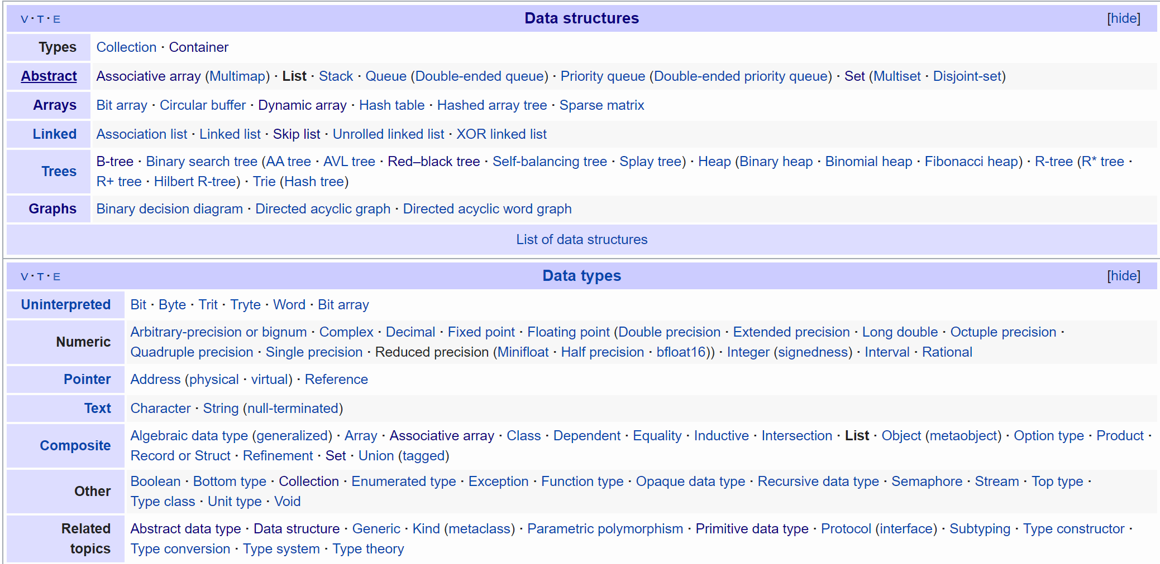

Wikipedia
Notes:
Bart: One last thing before we get started, I want to point out that Wikipedia is a great place to learn about data structures and abstract data types.
Bart: There are so many out there, and each one has a ton of details associated with it.
Bart: It’s useful to keep a short list in your head so you’re not constantly googling, but no one knows them all.
ATB: I know them all. I am a genius.
Bart: Great for you ATB. But we don’t know them, and that’s okay. The important thing is you know where to go to find out more about them.
Bart: And that’s a good lesson for all of computer science, really.

